Slide 1
Detection Error Probability Maximization for Disguised Full-Duplex Covert Communications
Mar. 29, 2024
Refat Khan, and Jihwan Moon

Slide 2
Table of Contents
1. Introduction
2. System model
3. Problem formulation
4. Proposed solutions
5. Numerical results

Slide 3
1. Introduction

Slide 4
2. System model

Slide 5
2. System model
2.1 Schematic diagram

Slide 6



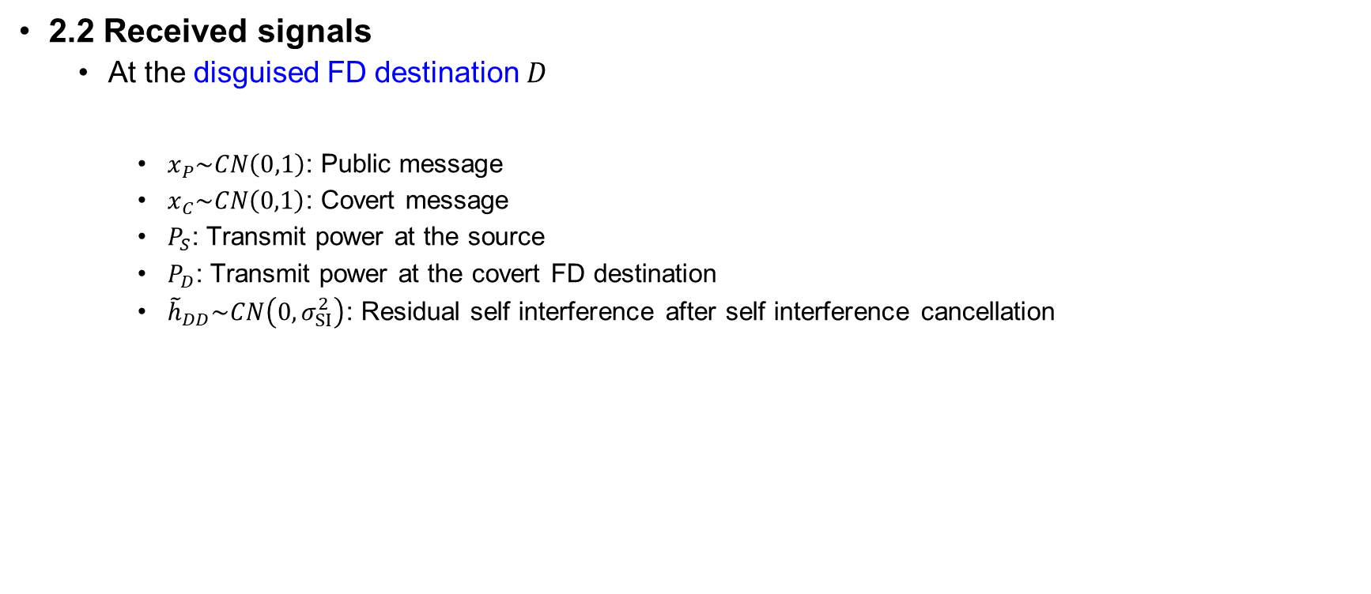

2. System model
2.2 Received signals
At the disguised FD destination $D$
$x_{P}\sim CN\left(0,1\right)$: Public message
$x_{C}\sim CN\left(0,1\right)$: Covert message
$P_{S}$: Transmit power at the source
$P_{D}$: Transmit power at the covert FD destination
${\tilde{h}}_{DD}\sim CN\left(0,σ_{SI}^{2}\right)$: Residual self interference after self interference cancellation
Public message, $x_{P}$
Covert message, $x_{C}$
Source, S
Disguised FD destination, D

Slide 7

2. System model
2.2 Received signals
At the disguised FD destination $D$
Channel capacity for the public message
Adaptive transmission policy with rate $r_{P}≤{\overline{r}}_{P,D}$ assumed, based on the feedback from the destination
Public message, $x_{P}$
Covert message, $x_{C}$
Source, S
Disguised FD destination, D

Slide 8



2. System model
2.2 Received signals
At the hidden receiver $R$
Channel capacity for the public message by treating the covert message as interference (if $r_{P}≤{\overline{r}}_{P,R}$)
Public message, $x_{P}$
Covert message, $x_{C}$
Source, S
Hidden
receiver, R
Disguised FD destination, D

Slide 9

2. System model
2.2 Received signals
At the hidden receiver $R$
Achievable rate for the covert message after canceling the decoded public message
Public message, $x_{P}$
Covert message, $x_{C}$
Source, S
Hidden
receiver, R
Disguised FD destination, D

Slide 10




2. System model
2.2 Received signals
At the warden $W$
Public message, $x_{P}$
Covert message, $x_{C}$
Source, S
Warden, W
Disguised FD destination, D

Slide 11

2. System model
2.3 Covert message detection
The worst-case assumption: $P_{D}$ known at the detector [HTa:20]
The effective residual signal assuming the warden successfully decoded $x_{P}$
The null and alternative hypotheses
The test statistics $T=E\left[{\left|{\tilde{z}}_{W}\right|}^{2}\right]$

Slide 12
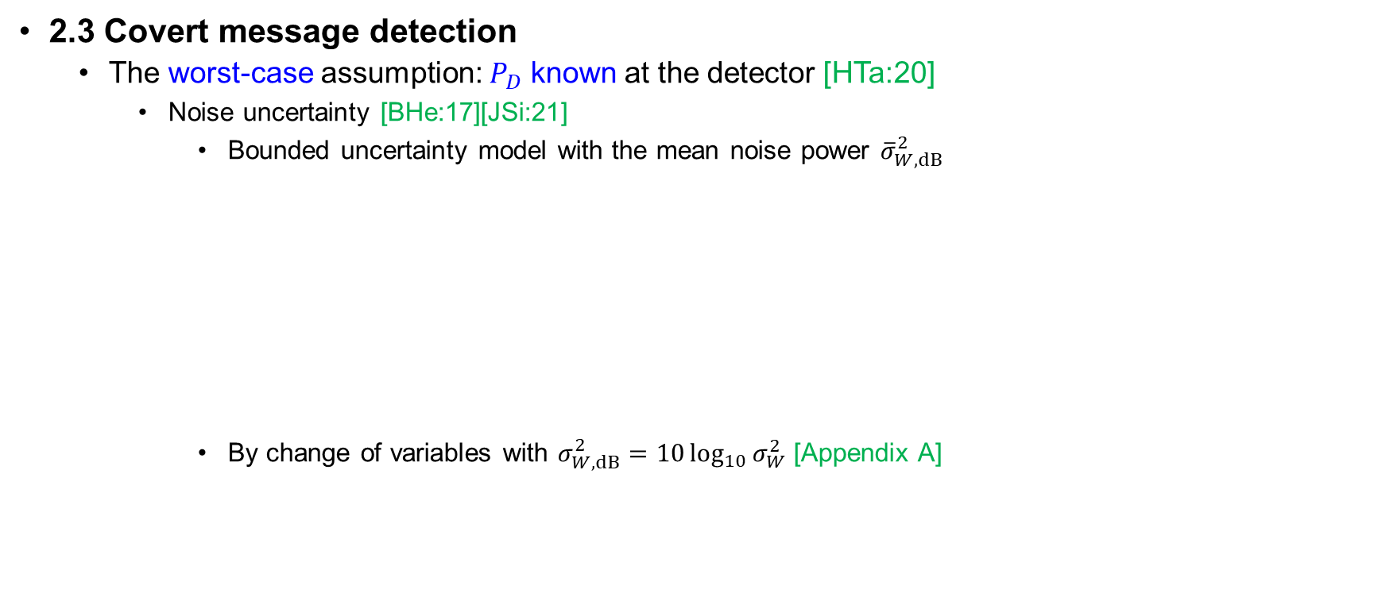
2. System model
2.3 Covert message detection
The worst-case assumption: $P_{D}$ known at the detector [HTa:20]
Noise uncertainty [BHe:17][JSi:21]
Bounded uncertainty model with the mean noise power ${\overline{σ}}_{W,dB}^{2}$
By change of variables with $σ_{W,dB}^{2}=10\log_{10}{σ_{W}^{2}}$ [Appendix A]

Slide 13

2. System model
2.3 Covert message detection
The worst-case assumption: $P_{D}$ known at the detector [HTa:20]
Decision based on a threshold $τ$
Detection error probability (DEP)
False alarm probability

Slide 14

2. System model
2.3 Covert message detection
The worst-case assumption: $P_{D}$ known at the detector [HTa:20]
Decision based on a threshold $τ$
Detection error probability (DEP)
Miss probability

Slide 15

2. System model
2.3 Covert message detection
The worst-case assumption: $P_{D}$ known at the detector [HTa:20]
Decision based on a threshold $τ$
Detection error probability (DEP)
Assuming the equally probable chance of the covert message, $\operatorname{Pr}\left(H_{0}\right)=\operatorname{Pr}\left(H_{1}\right)=\frac{1}{2}$

Slide 16
2. System model
2.3 Covert message detection
The worst-case assumption: $P_{D}$ known at the detector [HTa:20]
Decision based on a threshold $τ$
Detection error probability (DEP)
Assuming the equally probable chance of the covert message, $\operatorname{Pr}\left(H_{0}\right)=\operatorname{Pr}\left(H_{1}\right)=\frac{1}{2}$

Slide 17

2. System model
2.3 Covert message detection
The worst-case assumption: $P_{D}$ known at the detector [HTa:20]
The shape of the DEP function
Maximum error
= A random guess

Slide 18

2. System model
2.3 Covert message detection
The worst-case assumption: $P_{D}$ known at the detector [HTa:20]
The shape of the DEP function
Note that
The first derivative

Slide 19
2. System model
2.3 Covert message detection
The worst-case assumption: $P_{D}$ known at the detector [HTa:20]
The shape of the DEP function
Maximum error
= A random guess

Slide 20

2. System model
2.3 Covert message detection
The worst-case assumption: $P_{D}$ known at the detector [HTa:20]
The minimum DEP and the optimal threshold $τ^{⋆}$

Slide 21
3. Problem formulation

Slide 22
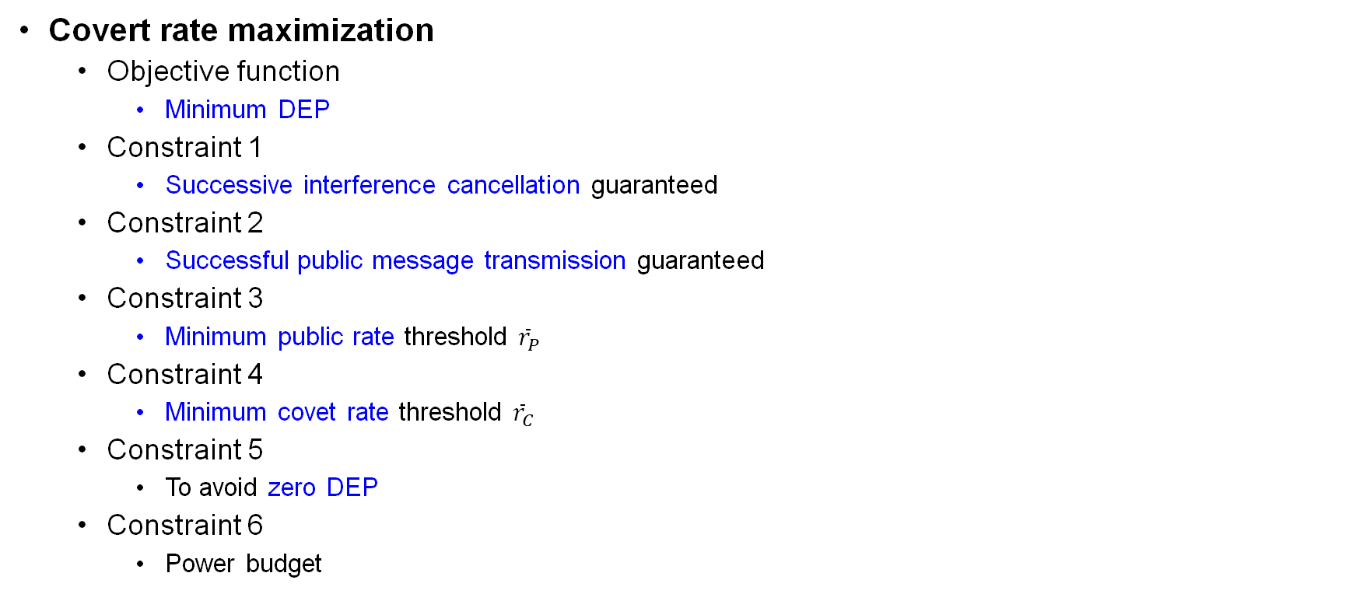
3. Problem formulation
Covert rate maximization
Objective function
Minimum DEP
Constraint 1
Successive interference cancellation guaranteed
Constraint 2
Successful public message transmission guaranteed
Constraint 3
Minimum public rate threshold ${\overline{r}}_{P}$
Constraint 4
Minimum covet rate threshold ${\overline{r}}_{C}$
Constraint 5
To avoid zero DEP
Constraint 6
Power budget

Slide 23
4. Proposed solutions

Slide 24
4. Proposed solutions
Hi
Hi

Slide 25
5. Numerical results

Slide 26
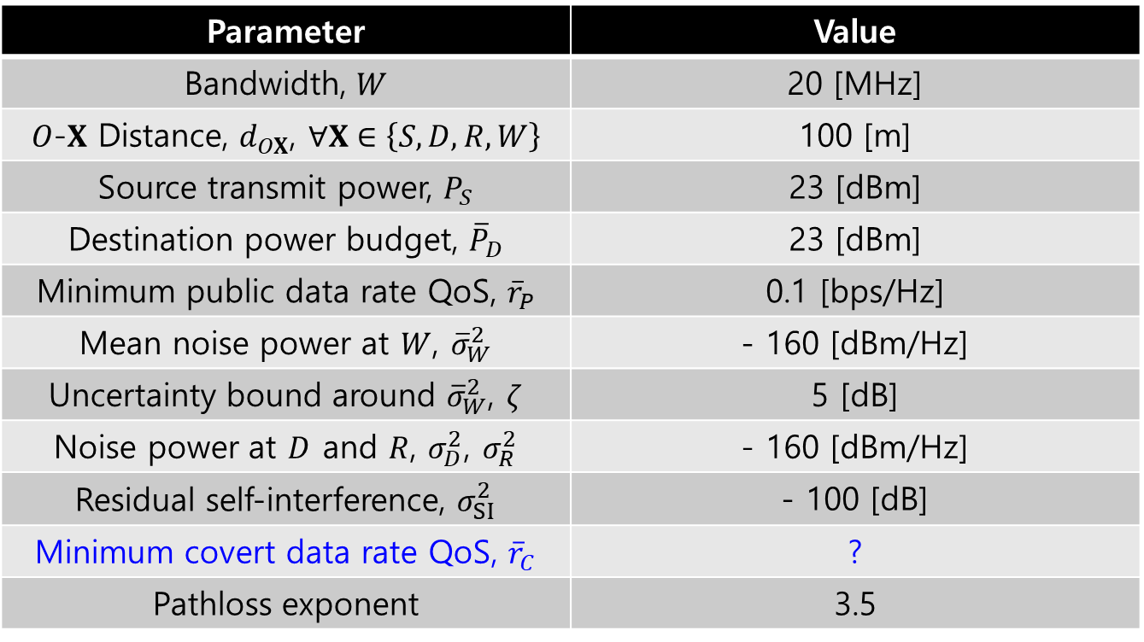
5. Numerical results
System parameter
Parameter | Value
Bandwidth, $W$ | 20 [MHz]
$O$-$X$ Distance, $d_{OX}$, $∀X∈\left\{S,D,R,W\right\}$ | 100 [m]
Source transmit power, $P_{S}$ | 23 [dBm]
Destination power budget, ${\overline{P}}_{D}$ | 23 [dBm]
Minimum public data rate QoS, ${\overline{r}}_{P}$ | 0.1 [bps/Hz]
Mean noise power at $W$, ${\overline{σ}}_{W}^{2}$ | - 160 [dBm/Hz]
Uncertainty bound around ${\overline{σ}}_{W}^{2}$, $ζ$ | 5 [dB]
Noise power at $D$ and $R$, $σ_{D}^{2}$, $σ_{R}^{2}$ | - 160 [dBm/Hz]
Residual self-interference, $σ_{SI}^{2}$ | - 100 [dB]
Minimum covert data rate QoS, ${\overline{r}}_{C}$ | ?
Pathloss exponent | 3.5

Slide 27
5. Numerical results
Node location

Slide 28

5. Numerical results
DEP vs. Source transmit power, $P_{S}$

Slide 29

5. Numerical results
DEP vs. Destination transmit power budget, ${\overline{P}}_{D}$

Slide 30

5. Numerical results
DEP vs. Minimum public rate threshold, ${\overline{r}}_{P}$

Slide 31

5. Numerical results
DEP vs. Residual self-interference, $σ_{SI}^{2}$

Slide 32

5. Numerical results
DEP vs. Minimum covert rate threshold, ${\overline{r}}_{C}$

Slide 33

5. Numerical results
DEP vs. Noise uncertainty bound, $ζ$

Slide 34
Appendix A

Slide 35
References
[HTa:20] S. W. Kim and H. Q. Ta, "Covert Communications Over Multiple Overt Channels," in IEEE Transactions on Communications, vol. 70, no. 2, pp. 1112-1124, Feb. 2022, doi: 10.1109/TCOMM.2021.3127532.
[BHe:17] B. He, S. Yan, X. Zhou and V. K. N. Lau, "On Covert Communication With Noise Uncertainty," in IEEE Communications Letters, vol. 21, no. 4, pp. 941-944, April 2017, doi: 10.1109/LCOMM.2016.2647716.
[JSi:21] J. Si et al., "Covert Transmission Assisted by Intelligent Reflecting Surface," in IEEE Transactions on Communications, vol. 69, no. 8, pp. 5394-5408, Aug. 2021, doi: 10.1109/TCOMM.2021.3082779.

